Slide 1

Auto Grading
Ruijie Geng
March 9, 2018
© 2018 RPI | An RCOS project

Slide 2
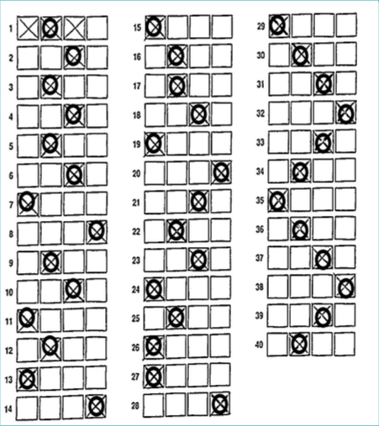
This semester:
Teachers are the main clients (large scale of grading)
Code reconstruction (divide different functionality into different module)
Supporting system (automation)
More functionality (web, database, handwriting recognition, file monitoring )
Overview

Slide 3






File Monitor
Grading
Web
Upload local files
Check monitored files and call Auto Grading API
Grading One Template (IBDP)
Handwriting recognition
User login
Back end
Front end
One table database for user login and scores storing

Slide 4

Milestone
Web
Completed
Improvement needed
In process
Not started yet
Improve existing web page
Setup database system
Discuss the frontend
Setup user login
Implement frontend
Implement user interface for mobile web

Slide 5
Database
Key | Name | Password | Level | Score | Exam name
Login
Get score
Store score

Slide 6
User Login
Achieved Goals
01
The function is able to let users to login to our system if he can offers correct username and password.
03
User registration function with email confirmation.
02
The registered users may store information on the system.
As a student, you can check your grades on different tests.
As a professor, you can store grades and answer sheets of all your students.
04
Safety protection such as password hashing and Cross-site Request Forgery
Future Goals
Notes:
Achieved Goals:
The function is able to let users to login to our system if he can offers correct username and password.
The registerd users may store information on the system.
As a student, you can check your grades on different tests.
As a professor, you can store grades and answer sheets of all your students.
Future Goals:
User regislation function with email comfirmation.
Safety protection such as password hashing and Cross-site Request Forgery

Slide 7


UI & LOGO
And more…

Slide 8

DEMO1
(Web & Database)

Slide 9


Complete second template
(Give up --><--)
Edge distribution
(Complete)
Explore how to use number recognition code to recognize the number in the answer sheet
(Use handwriting to replace)
Milestone
Grading
March
Implement function: find the number of questions
(Complete)
Implement function: find the layout of the template
(Complete)
Combine grading part with number recognition
(Complete)

Slide 10
CODE
reconstruction
NEW
sample
grading
grading.py
Box.py
answerSheet.py
web
app.py
static file
database
File monitor
Server.py
Client.py
test.py
app.py
grading.py
helperfunction.py
test.py
static file for front end
ORIGINAL

Slide 11

Use open source library pytesseract to recognize
Approximate 60% accuracy compare with correct name
Get handwriting names from specific region in answer sheet, and compare the result with name in database to find most close one.
”
Handwriting
recognition
BUT
Library just has few functions, so we can not improve accuracy
Notes:
http://www.lifeofpix.com/wp-content/uploads/2016/03/Life-of-Pix-free-stock-taxi-boat-sea-LEEROY.jpg
https://www.dropbox.com/s/vo8do30vu2kraao/250H.jpg?dl=1

Slide 12
“
Monitoring the changes in the file list
IO operations based on Python
Automatically calls the Grading API
Automatically update/move file
File Monitor
”
File Monitor

Slide 13
DEMO2
(Grading & Server)

Slide 14
Improve code
Database
User login
Grading algorithm
Handle different input image
Huge image quality difference between mobile cameras and scanners
Handle more template
Find a better library to recognize the handwriting information
Future

Slide 15
Professor Moorthy
Professor Turner
Professor Goldschmidt
The Mentors
Red Hat
THANKS
The RCOS Program
Python
OpenCV

